Slide 1


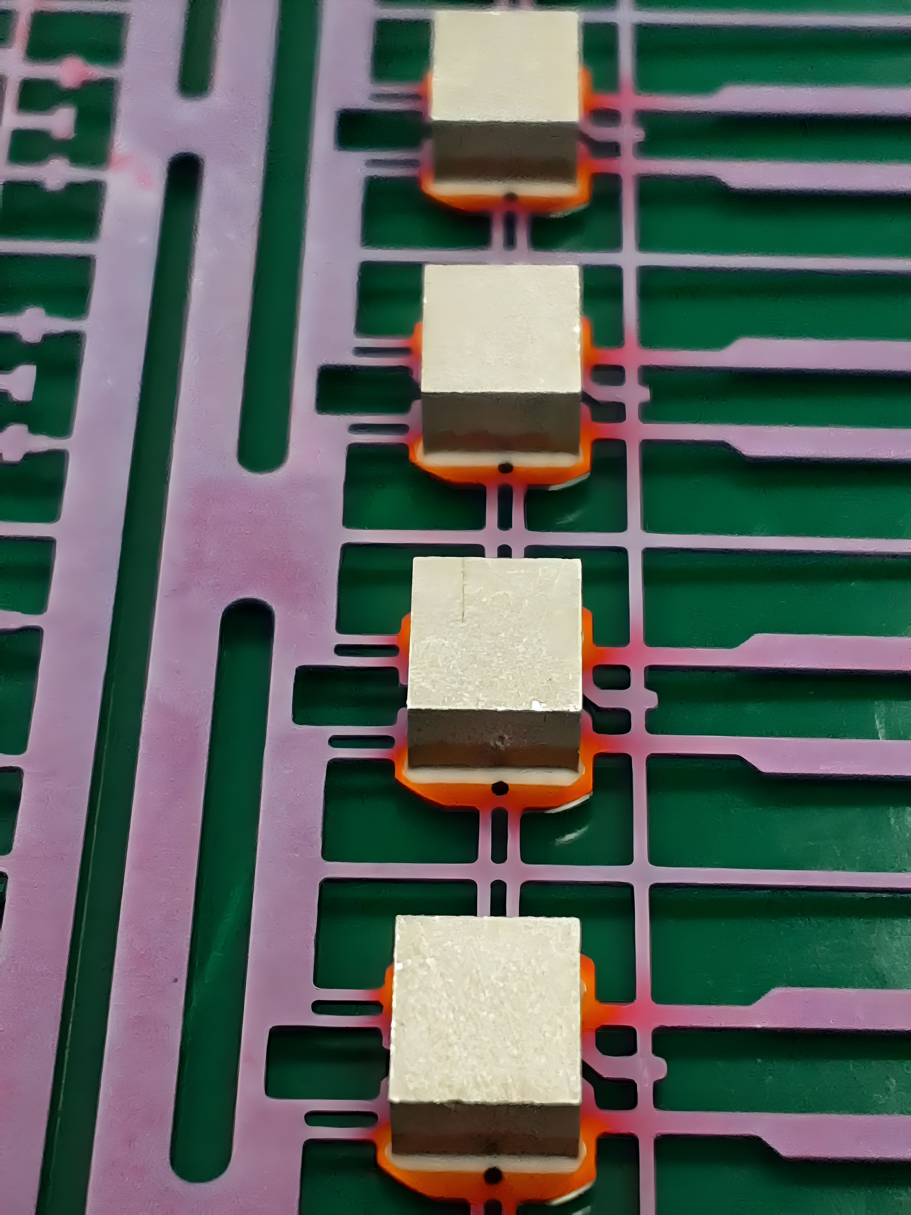
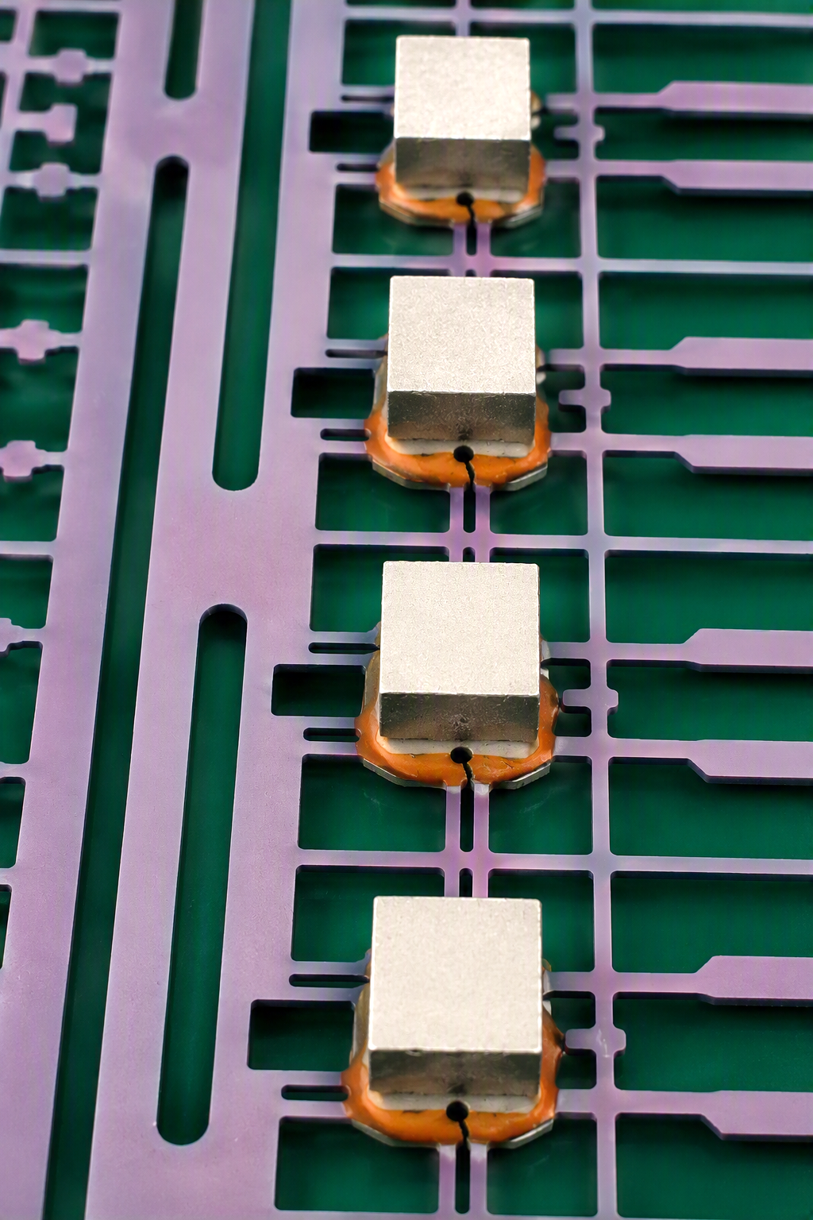


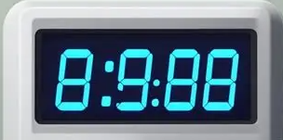

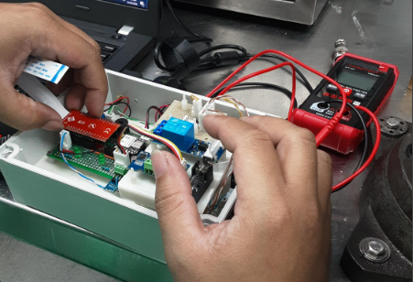
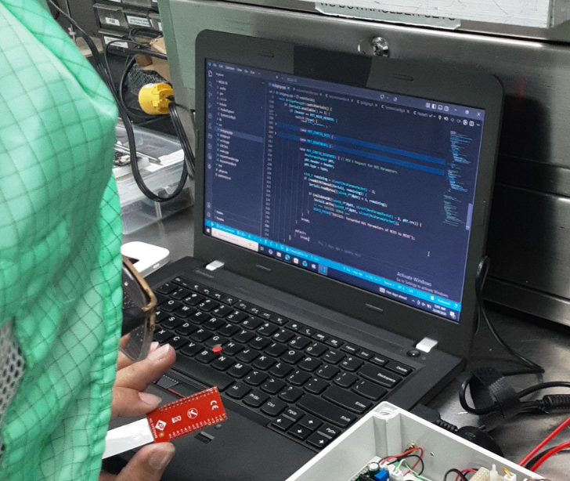
I.0 Background of the Study:
2.0 Statement of the Problem
3.0 Objective
Manual epoxy time monitoring is prone to human error and may result in the use of expired epoxy, potentially affecting Magnet Attach quality. An Epoxy Timer provides reliable monitoring to prevent expired epoxy usage and improve process control.
Encounter Expired Epoxy
Expired epoxy was used in production due to inadequate verification of the material's expiration date prior to use.
The current process relies solely on the production operator for epoxy expiration verification, with no secondary control or independent verification in place.
Reliance on a single verification point increases the likelihood of expired epoxy usage, which may adversely affect product quality and process performance.
Implementation of a Essemtec Epoxy Timer System for Real-Time Pot-Life Monitoring and Process Control
Minimizes risks of magnet lifting, voids, delamination, and weak magnet attachment.
Prevents the use of expired or out-of-pot-life epoxy.
Ensures consistent magnet bond strength and adhesion.
Provides alarms or notifications when epoxy approaches its allowable working time.
Reduces dependence on manual monitoring.
Optimizes epoxy consumption and prevents unnecessary disposal due to uncertainty of remaining pot life.
Automates timing and monitoring activities, allowing operators to focus on production tasks.
Maintains compliance with semiconductor manufacturing procedures and quality standards.
GOOD EPOXY QUALITY
EXPIRED EPOXY
Fully cured and hard
No Cracks
Smooth glossy surface
Strong reliable bond
Soft and tacky
Cracks in epoxy
Voids and pinholes
Magnet detach
Development
4.0 Root Cause Analysis
ASSEMBLY
PROGRAMMING
FISHBONE DIAGRAM
Based on the identified causes, the team developed an affordable in-house epoxy timer using readily available components and materials. The analysis highlighted two key contributors: Machine, due to the lack or high cost of timer integration, and Method, due to inconsistent timing and tracking practices. By addressing these factors, the team was able to implement a practical, touch screen technology and cost-effective solution for reliable epoxy time monitoring.
MAN
MACHINE
Failure to check pot-life log before use.
Misinterpretation of expiration time.
Operator forgets to record epoxy mix/start time.
Inadequate training on epoxy handling.
Lack of awareness of epoxy pot-life requirements.
Missed monitoring during busy production periods.
No automatic pot-life timer available.
HMI or workstation does not display remaining pot life.
Computerized tracking system unavailable or offline.
Lack of Fail-Safe Control to Prevent Operation Beyond Epoxy Pot-Life
s
Manual detection and control
-Inconsistent timing and tracking methods.
-Delayed identification of expired epoxy.
-No standardized epoxy pot-life monitoring procedure.
Lack of reaction plan when pot life is exceeded.
Epoxy pot life is short and difficult to track manually.
Temperature-sensitive epoxy with reduced actual pot life..
Excess epoxy prepared, increasing risk of prolonged use.
Different epoxy types have different pot-life limits.
USE OF EXPIRED EPOXY
Electronics Assembly
Mechanical Fabrication
Micro Controllers
Touch Screen Panel
Embedded Software Development
System Integration
HMI/UI Design
METHOD
MATERIAL

Slide 2



AUTHORS
Jake Vincent Basalo
Marc Lorenz Coruña
Ryan Balaguer

